Slide 1

Stock Profile 2017
Analysis Report
Deependra Singh Rathore
(Acted as – Data Visualization Developer)
(Yahoo Finance!)

Slide 2
STATUS SUMMARY
Data Collection File (CSV)
File Data Extraction
Data Analysis (As Per Requirements)
Data Visualization in Different Form
Scatter Visualization
Violin Visualization
Bar Visualization, etc.

Slide 3


Data Briefing
The data given below we used for the analysis and visualization and comparison between them.
Netflix Stock Data
Dow Jones Industrial Data
Netflix Stocks of the Year 2017 has been collected in the two tables i.e. Daily Basis and Quarter Basis
Daily Basis table contains Open , Closed and Yahoo Stock Adjacent Closed Amount, etc. Attributes.
It contains the Dow Jones Industrial Average Price of the 2017.
It has Open, Closed and Yahoo Stock Adjacent Closed Amount etc. Attributes.

Slide 4
Analysis Details
Summary of Netflix stock and revenue For the past four quarters
Distribution of Stock Prices For Netflix in 2017
Brief summary of their earned versus actual earnings per share
Netflix stock against the Dow Jones stock
Earnings and revenue reported by Netflix

Slide 5
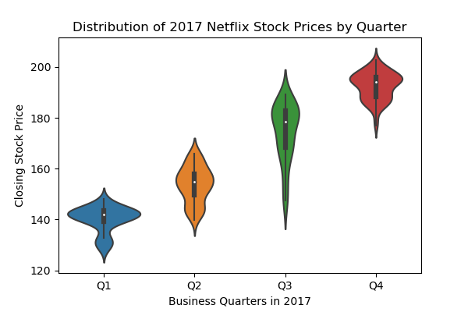
NETFLIX STOCK AND REVENUE (2017)
Graph Analysis
The graph show distribution between the different business quarter of the Netflix stock in 2017.
It shows the closing stock price of different quarters.
Results:-
Max Closing price fall between Range of 140-180 Throughout the year.
Max Stock Price Closed :- Q4
Min Stock Price Closed :- Q1

Slide 6
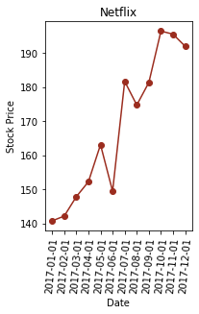
NETFLIX STOCK PRICES (2017)
Graph Analysis
The graph show distribution of Netflix Stock Price on the different months of the Year 2017.
It shows the stock price of different Dates.
Results:-
Max Stock Price Month:- Oct, 2017
Min Stock Price Month:- Jan, 2017

Slide 7
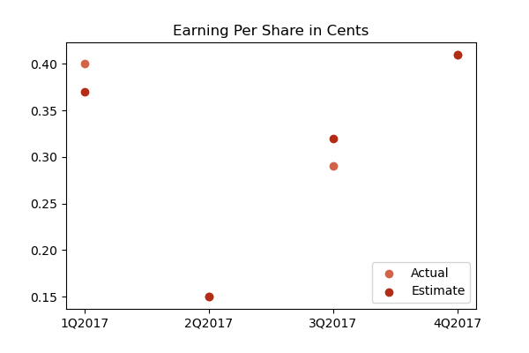
EARNED V/S ACTUAL EARNINGS (2017)
Graph Analysis
The graph show distribution of Netflix estimated earning and actual earning in 2017.
It shows the both earning per share in cents.
Results:-
There is some differences between in estimated and what actually earned.
But, we observe the graph that two quarters i.e. 2Q and 4Q of 2017 then their the actual earning has meets what we estimated in that quarter.

Slide 8
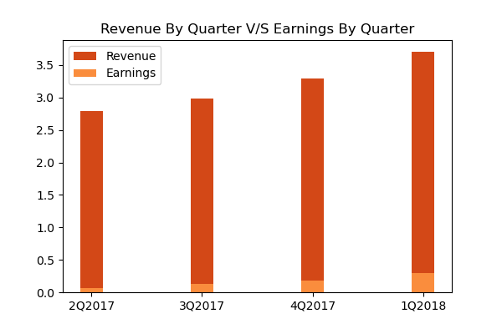
EARNING V/S REVENUE (NETFLIX, 2017)
Graph Analysis
The graph shows the Revenue and Earning by Netflix on basis of quarter of the year 2017.
Upper bar shows the Revenue and Lower bar shows the Earning.
Results:- We clearly observe in the graph that earning is continuously increasing over the quarters of 2017 except between Q1 and Q2 there is major cut in revenue and earnings.
Least Earning:- 2Q
Max Earning:- 1Q

Slide 9
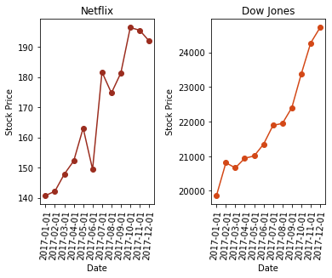
NETFLIX STOCK PRICES (2017)
Graph Analysis
There are two graphs one of Netflix Stocks and other of Dow Jones Industrial Average Price.
They shows different stock prices at the different months of the 2017.
Results:-
Netflix Stock Prices:-
Max Price:- Nearly 190(Oct,2017)
Min Price:- Nearly 140(Jan,2017)
Dow Jones Industrial Average Prices:-
Max Price:- greater than 24,000(Dec,2017)
Min Price:- less than 20,000(Jan,2017)

Slide 10
BIBILOGRAPHY
JUPYTER NOTEBOOK
Most of the data and graphs has been collected from the jupyter notebook.
DIFFERENT SOURCES
Codecademy and their different Sources from the Data has been collected.

Slide 11
THANK YOU
Any Suggestion and Queries Regarding this Presentation.

